Slide 1
Fabric security: everything you need to know!

Slide 2
PLEASE DO NOT COPY THESE SLIDES. THERE WILL BE MANY UPDATES IN THE NEXT FEW MONTHS AND IT IS IMPORTANT TO STAY UP TO DATE.
Please make sure you update regularly.

Slide 3


The latest security related information
For all the latest security related information please visit:
aka.ms/MSFabricSecurity
This slide deck:

Slide 4
Agenda
1
Intro to Fabric as a SaaS platform
2
Network and Identity security
3
Workspace & item security
4
Secure and compliant by default
5
Data security & governance

Slide 5
A world awash with data…

Slide 6
How do you translate data into competitive advantage?
Notes:
Menu for core section on this slide

Slide 7
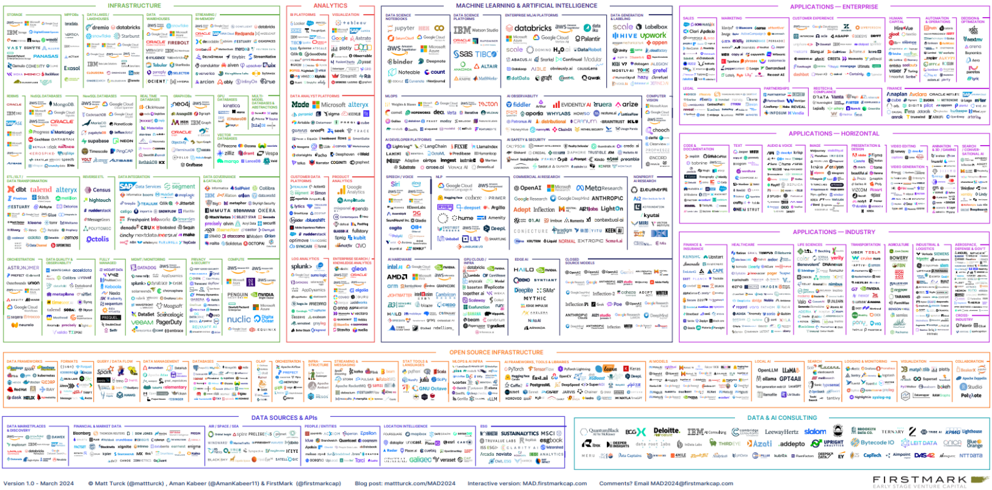
The 2024 ML, AI, and Data Landscape

Slide 8
Chief Data Officer quote
Simplify,
I am the Chief Data Officer and don’t want to be the Chief Integration Officer.
Every CDO, Every Enterprise

Slide 9

Microsoft Fabric - Data analytics for the era of AI 1
Microsoft Fabric
Data analytics for the era of AI
Complete Analytics Platform
Unified product, experience, and architecture
Delivered as SaaS
Notes:
Microsoft Fabric accelerates data potential for the era for AI.
Fabric provides a unified intelligent data foundation for all analytics workloads and integrates Power BI, Data Factory and the next generation of Synapse to offer customers a price performant and easy to manage modern analytics solution
Every analytics workload works seamlessly with OneLake to minimize data management time and effort by eliminating data movement and duplication
Fabric reduces the pain of Factory and facilitates better collaboration with a solution that makes it easy to connect and use the different analytics tools your team needs

Slide 10
Microsoft Fabric - Data analytics for the era of AI 2
Microsoft Fabric
Data analytics for the era of AI
Complete Analytics Platform
Lake Centric and Open
Unified product, experience, and architecture
Common SaaS data lake shared by all compute engines
Delivered as SaaS
Deep commitment for open formats and APIs
Notes:
Microsoft Fabric accelerates data potential for the era for AI.
Fabric provides a unified intelligent data foundation for all analytics workloads and integrates Power BI, Data Factory and the next generation of Synapse to offer customers a price performant and easy to manage modern analytics solution
Every analytics workload works seamlessly with OneLake to minimize data management time and effort by eliminating data movement and duplication
Fabric reduces the pain of Factory and facilitates better collaboration with a solution that makes it easy to connect and use the different analytics tools your team needs

Slide 11








Microsoft Fabric - The unified data platform for the era of AI
Microsoft Fabric
The unified data platform for the era of AI
Data
Factory
Analytics
Databases
Real-Time Intelligence
Power BI
AI
OneLake
Purview
Notes:
Fabric provides a unified intelligent data foundation for all analytics workloads and integrates Power BI, Data Factory and the next generation of Synapse to offer customers a price performant and easy to manage, modern analytics solution. It is a single SaaS service so you don’t have to worry about setting up a VM or spin anything up. Microsoft will take care of it.

Slide 12
Microsoft Fabric 1
Microsoft Fabric 1
End-to-end analytics data fabric From the data lake to the business user
Complete Analytics Platform
Lake centric and open
Empower Every Office User
Pervasive security and governance
Everything, Best of Breed
Unified
Azure OpenAI Copilots
OneLake
One Copy
Always Synced
Familiar and intuitive
Built into Office
Insight to action
End to end visibility
Always governed
Secure by default

Slide 13
Microsoft Fabric End-to-end analytics data fabric from the data lake to the business user1
Microsoft Fabric 1
Pervasive Security and Governance for the cloud world
Complete Analytics Platform
Lake centric and open
Empower Every Office User
Pervasive security and governance
Everything, Best of Breed
Unified
Azure OpenAI Copilots
OneLake
One Copy
Always Synced
Familiar and intuitive
Built into Office
Insight to action
End to end visibility
Always governed
Secure by default

Slide 14
Modern data challenges
Bring data to the masses, everyone should have access to data to make decisions
Instant access to the latest data, no copying around
Modern workforce, anywhere, any device
At the same time, you need to secure, govern and audit your data to protect customers and the company
SaaS platforms are designed with these challenges in mind.
Shift from siloed PaaS to integrated SaaS
Notes:
Fabric provides a unified intelligent data foundation for all analytics workloads and integrates Power BI, Data Factory and the next generation of Synapse to offer customers a price performant and easy to manage, modern analytics solution. It is a single SaaS service so you don’t have to worry about setting up a VM or spin anything up. Microsoft will take care of it.

Slide 15
Common network security requirements
Need to be able to connect to data inside a firewall\private link from Fabric (outbound)
Inbound protection (restrict inbound by network location)
Secure access to the “backend services”
More stringent customers (FSI\HLS):
Traffic needs to be private (not via public internet)
Endpoints should not be open to the public internet
Notes:
Fabric provides a unified intelligent data foundation for all analytics workloads and integrates Power BI, Data Factory and the next generation of Synapse to offer customers a price performant and easy to manage, modern analytics solution. It is a single SaaS service so you don’t have to worry about setting up a VM or spin anything up. Microsoft will take care of it.

Slide 16





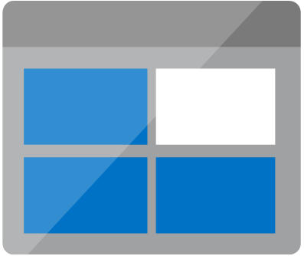
Existing PaaS World
Existing PaaS World
Synapse
PaaS services are disconnected from the Public internet.
All communications between the services are configured to go through private endpoint
Developers connect to a VPN and connect to the backend services
Data sources are connected through the self-hosted runtime inside the firewall
When the CEO access the data in Power BI Report, the data is imported into Power BI or through the GW with DQ.
Public Internet
FIREWALL
Customer VNet
Business
Data Sources
Private Endpoint
Developers
On-premises data gateway
Data is moved out or through GW
Self-Hosted Integration Runtime
Private Endpoint
Power BI
Storage Account (ADLS)
Public Internet
ADF
Public Internet

Slide 17



Microsoft Fabric – SaaS World
Business
Entra ID
Developers
Users connect to the SaaS service from global network
Endpoints and access are protected using Entra ID
All internal communications between the experiences happens through MS backbone network
When the CEO access the data in Power BI Report, the data is fetched directly from the OneLake instantly and securely without copying or moving
Data
Factory
Analytics
Databases
Real-Time Intelligence
Power BI
Industry Solutions
Partner
workloads
OneLake
Intelligent data foundation

Slide 18
Security layers in Microsoft Fabric
Network security
Workspace & item security
Data security
Your data in Fabric
…
Regulations & Certification
Data Encryption
High Availability & Disaster Recovery
E2E Auditability with Microsoft Purview
Information protection labels with Microsoft Purview
Additional advanced tools in Microsoft Purview
3rd party and in-house governance & security solutions
Notes:
Speaker: Adi Regev
Microsoft Fabric’s SaaS architecture and industry-leading security tools can help you simplify and accelerate security configuration while ensuring your data is protected at every step of its journey.
Fabric comes with always-on, default security and a wide set of tools so you can more easily manage the security needed for every scenario. Data users and security admins get specific tools designed for them so everyone can help ensure only the right people have access to the right data.
Microsoft Fabric is also certified with a huge range of industry compliance standards and provides full control over your data’s location so you can always remain compliant. All of this functionality comes in a cloud-based, pre-integrated and optimized SaaS environment—removing much of the cost and responsibility for maintaining your security.
Data security – RLS/CLS on semantic model, kustoDB, SQL DB, Fabric DW….
Onesecuirty – control roles to define access to data (for LH, other WLs to follow)
********************************************************************************************************
These are the security layers in Fabric:
Uppermost layer is the network security, to ensure there is no data leakage. Inbound network security to protect network traffic coming into Fabric (with private links, and Conditional access using Entra ID) and it is about outbound security to ensure secured connection with external data sources with Managed private endpoints and managed virtual networks, ip allowed list and more.
Next layer is for the workspace and item owners to manage access to their data and to define rls and cls as needed.
The next layer is data security, that it brings the power of Purview security together with Fabric to help you better protect you data.

Slide 19
Network security

Slide 20
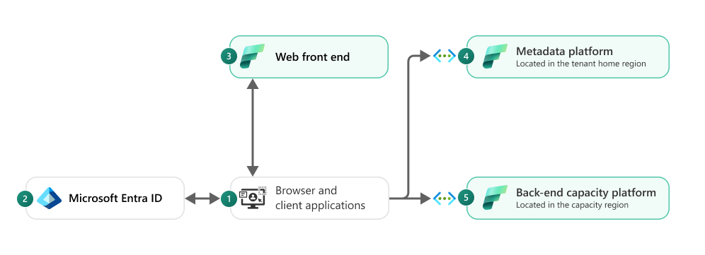
Microsoft Fabric Architecture
Fabrics is built as a SaaS product
Users connect to “Front End Services” and we are using “Entra ID” to authenticate and trust all requests.
All the clusters are protected behind “back-end services” and v-nets.
Traffic between experiences is going over MS backend network
Traffic to Fabric will be using at least TLS 1.2
Notes:
Fabric is a SaaS Service.
Users connect only to “Front End Services” and we are using “Entra ID” to authenticate and trust all requests.
All the clusters are protected behind “back-end services”.

Slide 21
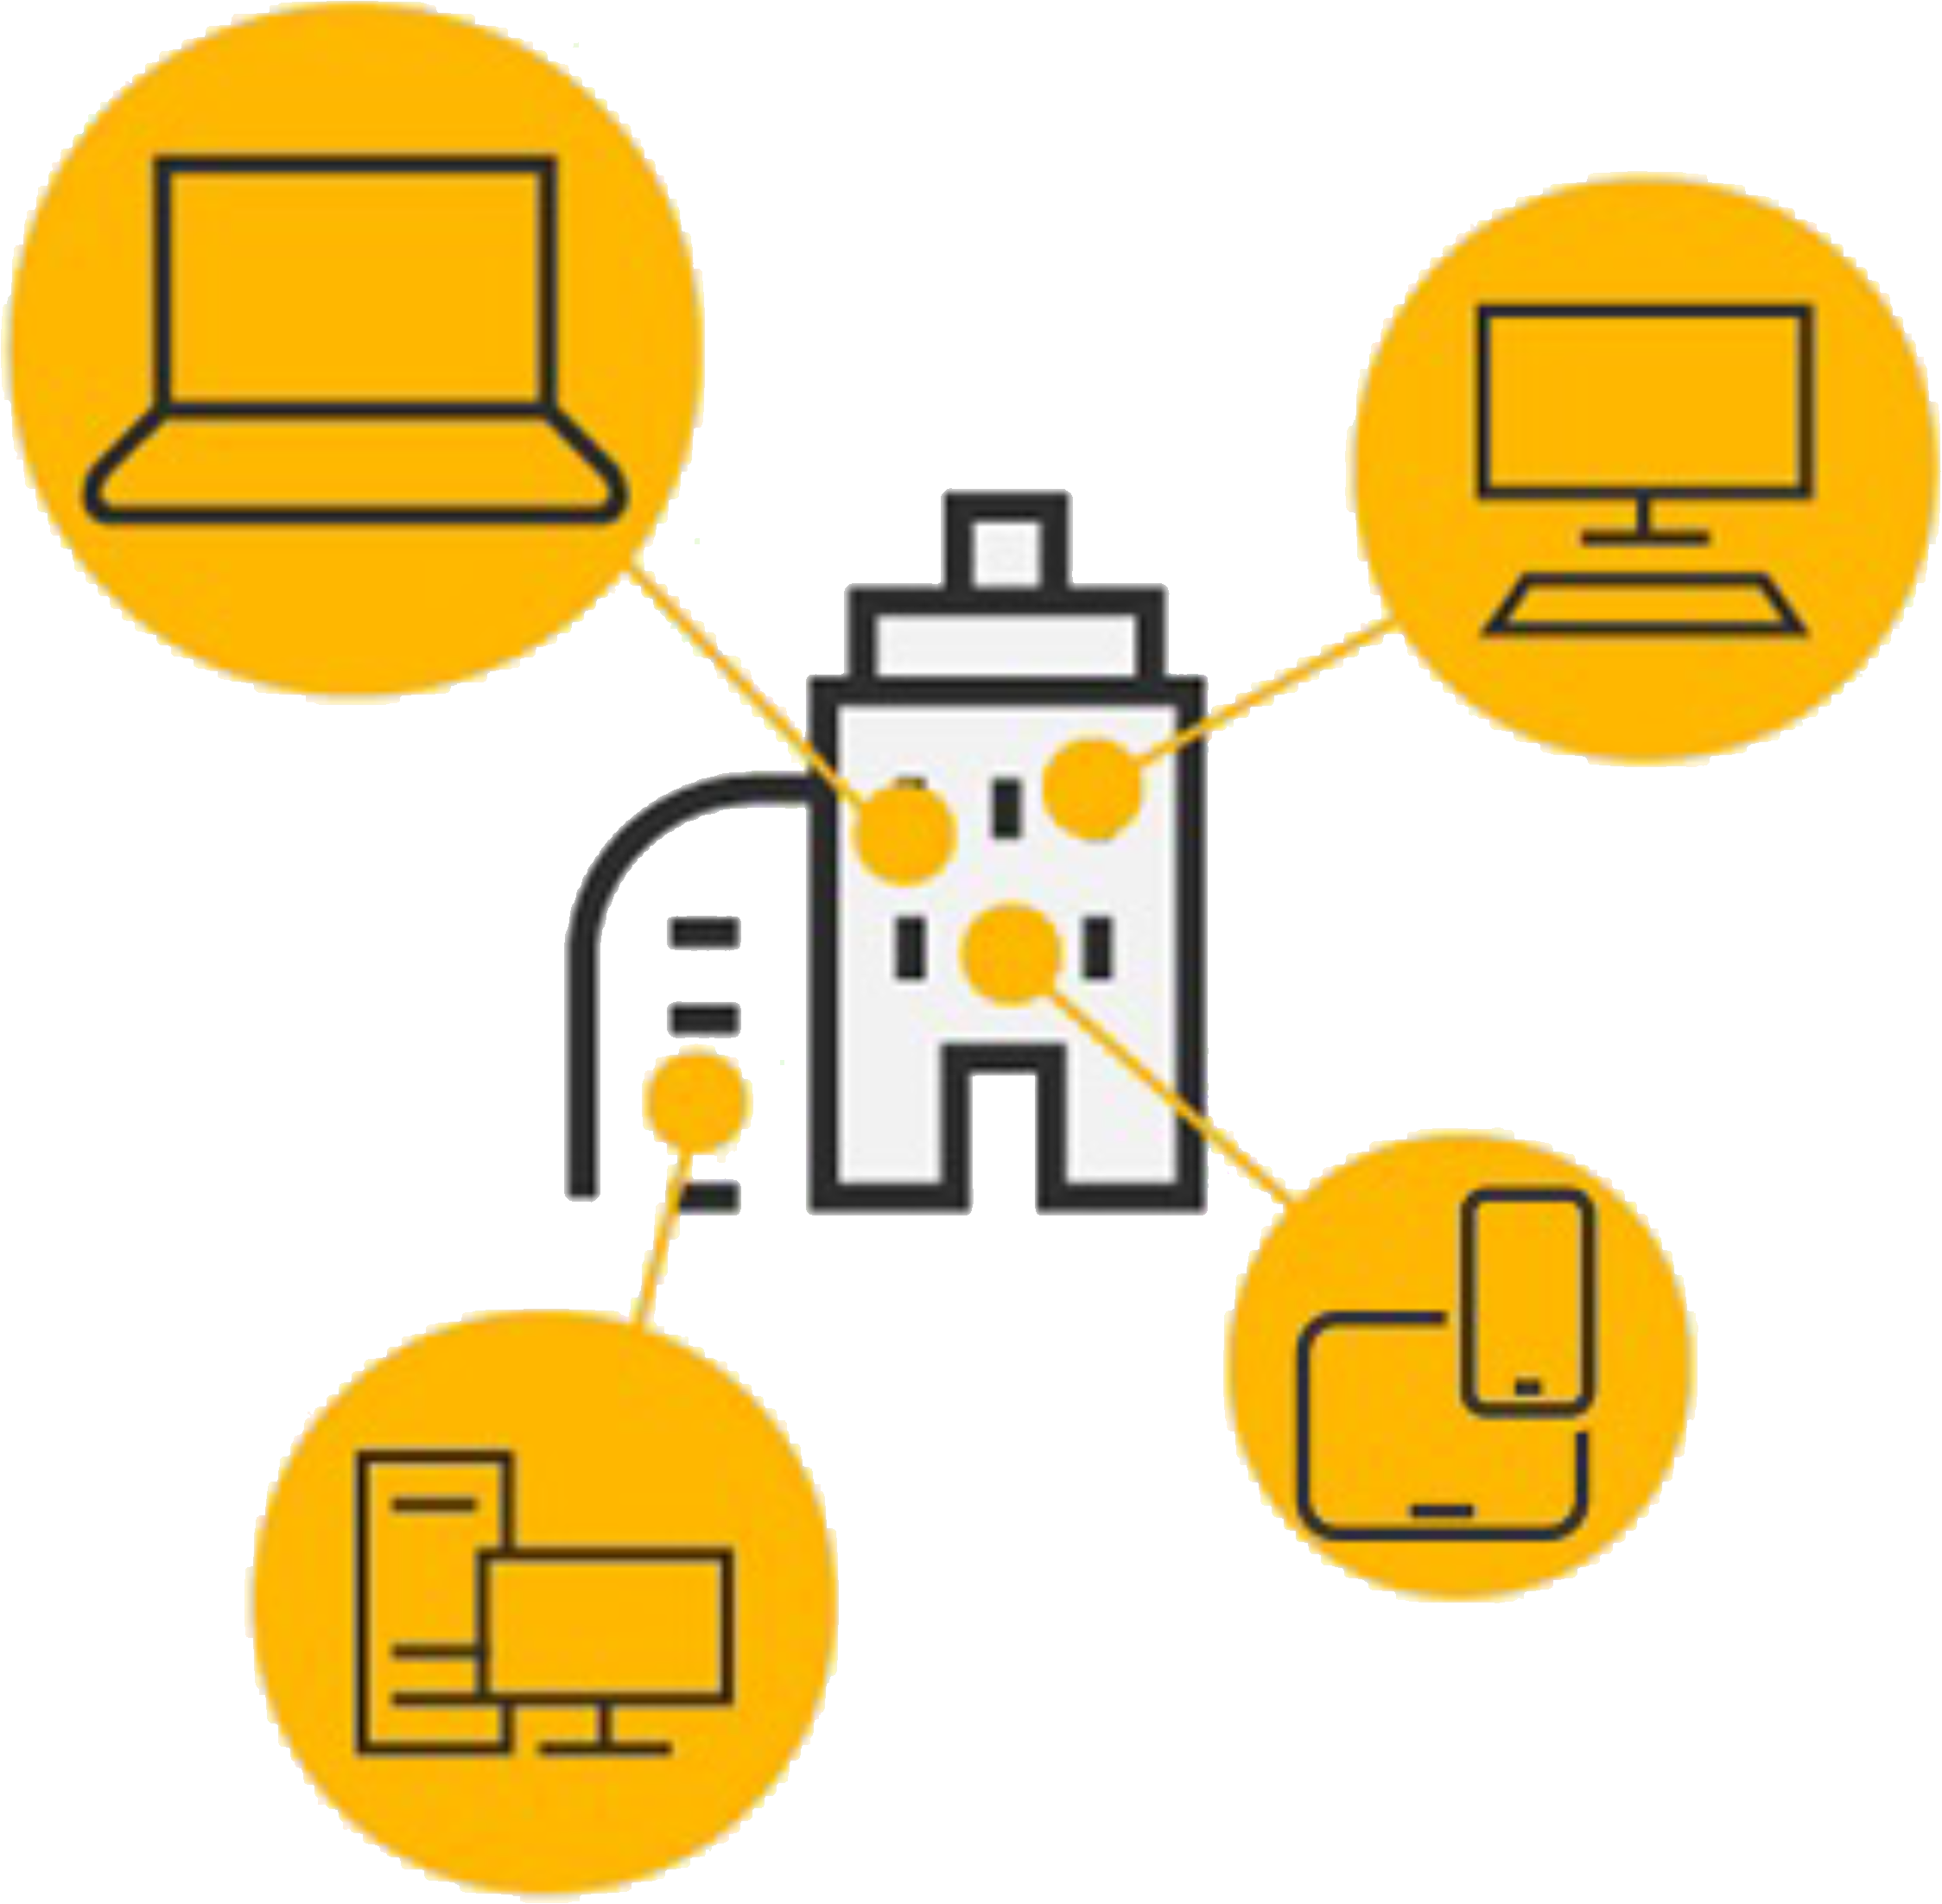
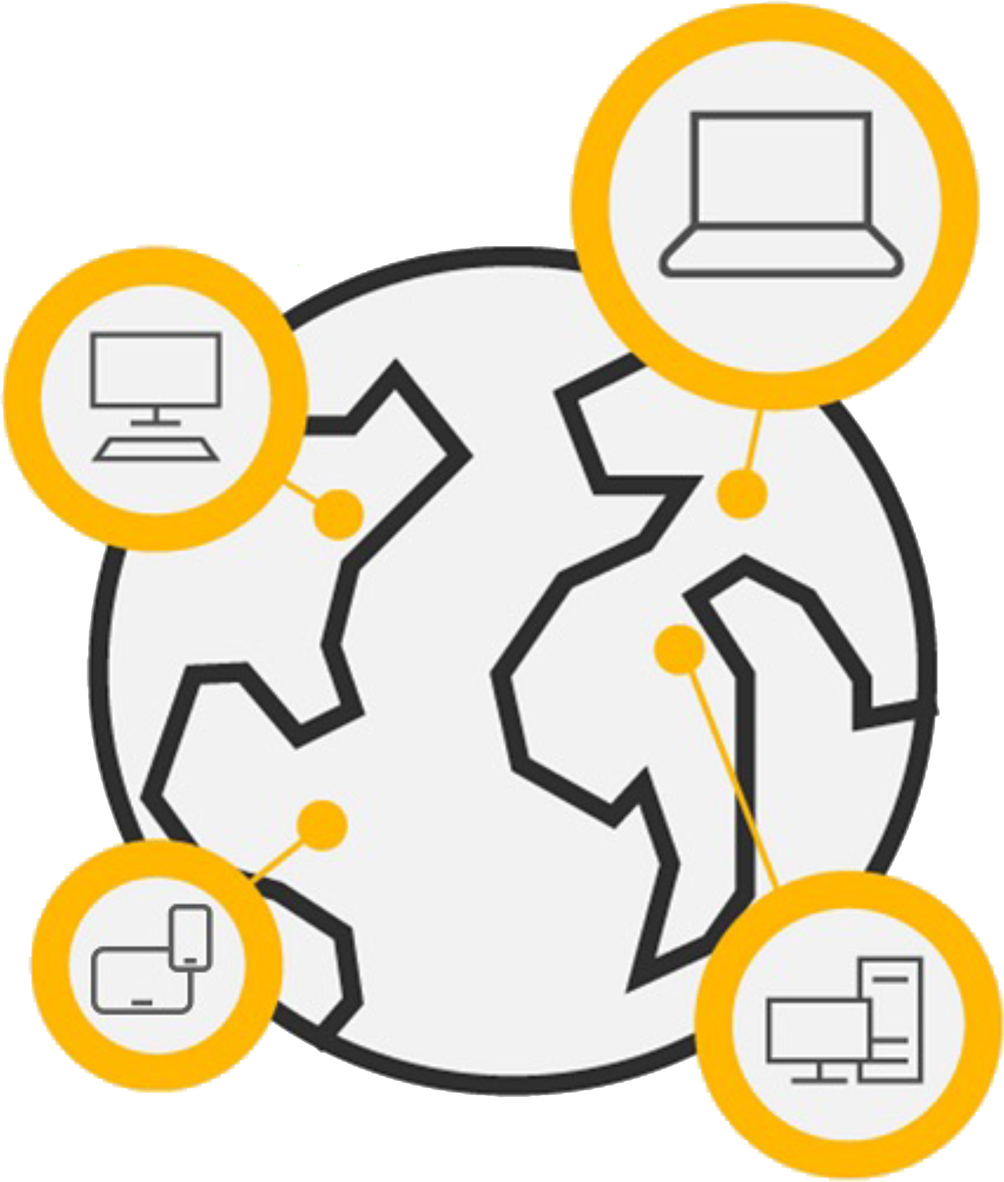
Inbound protection options
Perimeter Network Security
Zero Trust Approach
From limited known locations
to unknown locations
Notes:
Traditional network security approaches that use legacy VPNs simply cannot scale to modern demands. Once your remote users connect to your corporate network through VPN, they are granted excessive access to your entire network, all it takes is a single compromised user account, infected device, or open port for an attacker to gain entry, move laterally, and access your most critical assets.

Slide 22




New principles for Zero Trust in today’s reality
Verify explicitly
Use least privilege access
Assume breach

Slide 23

Fabric leverages Entra ID for secure adaptive access
Protect access to resources and data with strong authentication and risk-based access policies
User-friendly multifactor authentication (MFA) and Passwordless authentication support
Configurable Conditional Access policies based on context and risk assessment ¹
User and entity behavior analytics (UEBA) to automatically protect against identity compromise ²
¹Microsoft Entra ID P1 \ E3 license required
²Microsoft Entra ID P2 \ E5 license required
Notes:
Talk Track:
Is your end user authentication seamless and secure?
How much control do you have over access?
How do you secure identities against current and emerging threats?
So, our approach in identity and access management is really threefold:
secure authentication that is convenient for end-users
Conditional access to reach Zero trust
Identity protection - safeguard those identities when they are used as part of an OS session or application session.
The first question to ask yourself is, can I make my access protection stronger while also making things easier for users? This is about how people sign in, how often they have to sign in, and how we authenticate that they are who they say they are.
We find that across all of our analytics, that the proper application of a username and password is not a tremendous predictor of a genuinely authenticated person. In other words, just knowing the username and password doesn't prove that I am who I say I am. How can we improve that? How can we get to a world that's beyond passwords, beyond what we know are faulted technology for proving authentication, and at the same time make it easier for end users?
The second question is, how much control do you really have over access? Not only who is accessing what but also, can those access control policies change depending on the conditions?
So, for example, I might be a very trustworthy employee of Microsoft today, and I might be allowed to access certain sensitive information. Tomorrow, I might be a slightly less trustworthy employee, for a variety of reasons we'll get into in a moment, and I might not be allowed to access that same information. Can your access control policies adapt to those changing conditions? Can you make decisions on the fly? This is a technique being championed by many industry experts and analysts.
Some analysts refer to this as adaptive security. The identity space is the primary control point for such a capability.
And then lastly, we ask, how do you protect user credentials? This is really about, in this imperfect world where we do sometimes rely on username and password, keeping those credentials protected once they're used. So that when they're stored as part of an operating system session for example, that they can't be hijacked by an attacker and then used to access other things that the genuine legitimate user is not trying to access.
Microsoft Entra Plans and Pricing | Microsoft Security
EMS Overview
© 2014 Microsoft Corporation. All rights reserved. Microsoft, Windows, Surface and other product names are or may be registered trademarks and/or trademarks in the U.S. and/or other countries. The information herein is for informational purposes only and represents the current view of Microsoft Corporation as of the date of this presentation. Because Microsoft must respond to changing market conditions, it should not be interpreted to be a commitment on the part of Microsoft, and Microsoft cannot guarantee the accuracy of any information provided after the date of this presentation. MICROSOFT MAKES NO WARRANTIES, EXPRESS, IMPLIED OR STATUTORY, AS TO THE INFORMATION IN THIS PRESENTATION.
6/26/2025
23

Slide 24
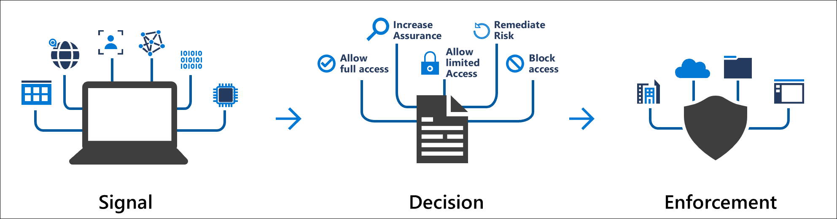



Conditional Access Policies
Common Decisions – Block, Grant, Require MFA
Users and Groups
Network Location
Entra Conditional Access Policies
Inbound
Applications
OneLake
Microsoft Fabric
Devices
Notes:
Microsoft Entra Conditional Access brings signals together, to make decisions, and enforce organizational policies.
Common Signals – Users, Devices and Locations
Common Decisions – Block, Grant, Require MFA
Conditional Access policies at their simplest are if-then statements; if a user wants to access a resource, then they must complete an action. For example: If a user wants to access an application or service like Microsoft 365, then they must perform multifactor authentication to gain access.

Slide 25

Private Link for Fabric
Perimeter Network Security for your tenant
What it means:
On-prem
Azure VNets
1.
Fabric is disconnected from the public internet
ExpressRoute / VPN
Peering
Azure Private Link (Tenant Level)
2.
Every users needs to connect to the private network to get access on every device
Private Endpoint
Customer VNet1
3.
No longer able to load resources locally (slower reports)
Inbound
Users & Groups
OneLake
4.
Increases ExpressRoute bandwidth and added costs for Private Links
Network Location
Microsoft Fabric
5.
Several product limitations (like on-prem data gateway)
Entra Conditional Access Policies
Devices
Applications

Slide 26

Workspace level Private Link for Fabric
Perimeter Network Security for your workspace
On-prem
Azure VNets
Fabric Tenant
ExpressRoute / VPN
Peering
Workspace A
Workspace B
Azure Private Link
Lakehouse
Warehouse
Notebook
Private Data Access
Semantic Model
Report
Entra Conditional Access Policies
Private Endpoint
(Workspace Level)
(Tenant Level)
OneLake
Spark Job Definition
Pipeline
KQL Database
Customer VNet1
Disabled
Enabled (with Entra Conditional Access Policies)
Public Access
Selected workspaces can be protected using Private Links and closed from public internet.
Create a secure connection between public and private workspaces using private data access.
Public workspaces are secured through Entra policies for example to use Power BI.
Limitations of tenant wide PL don’t apply !!!

Slide 27
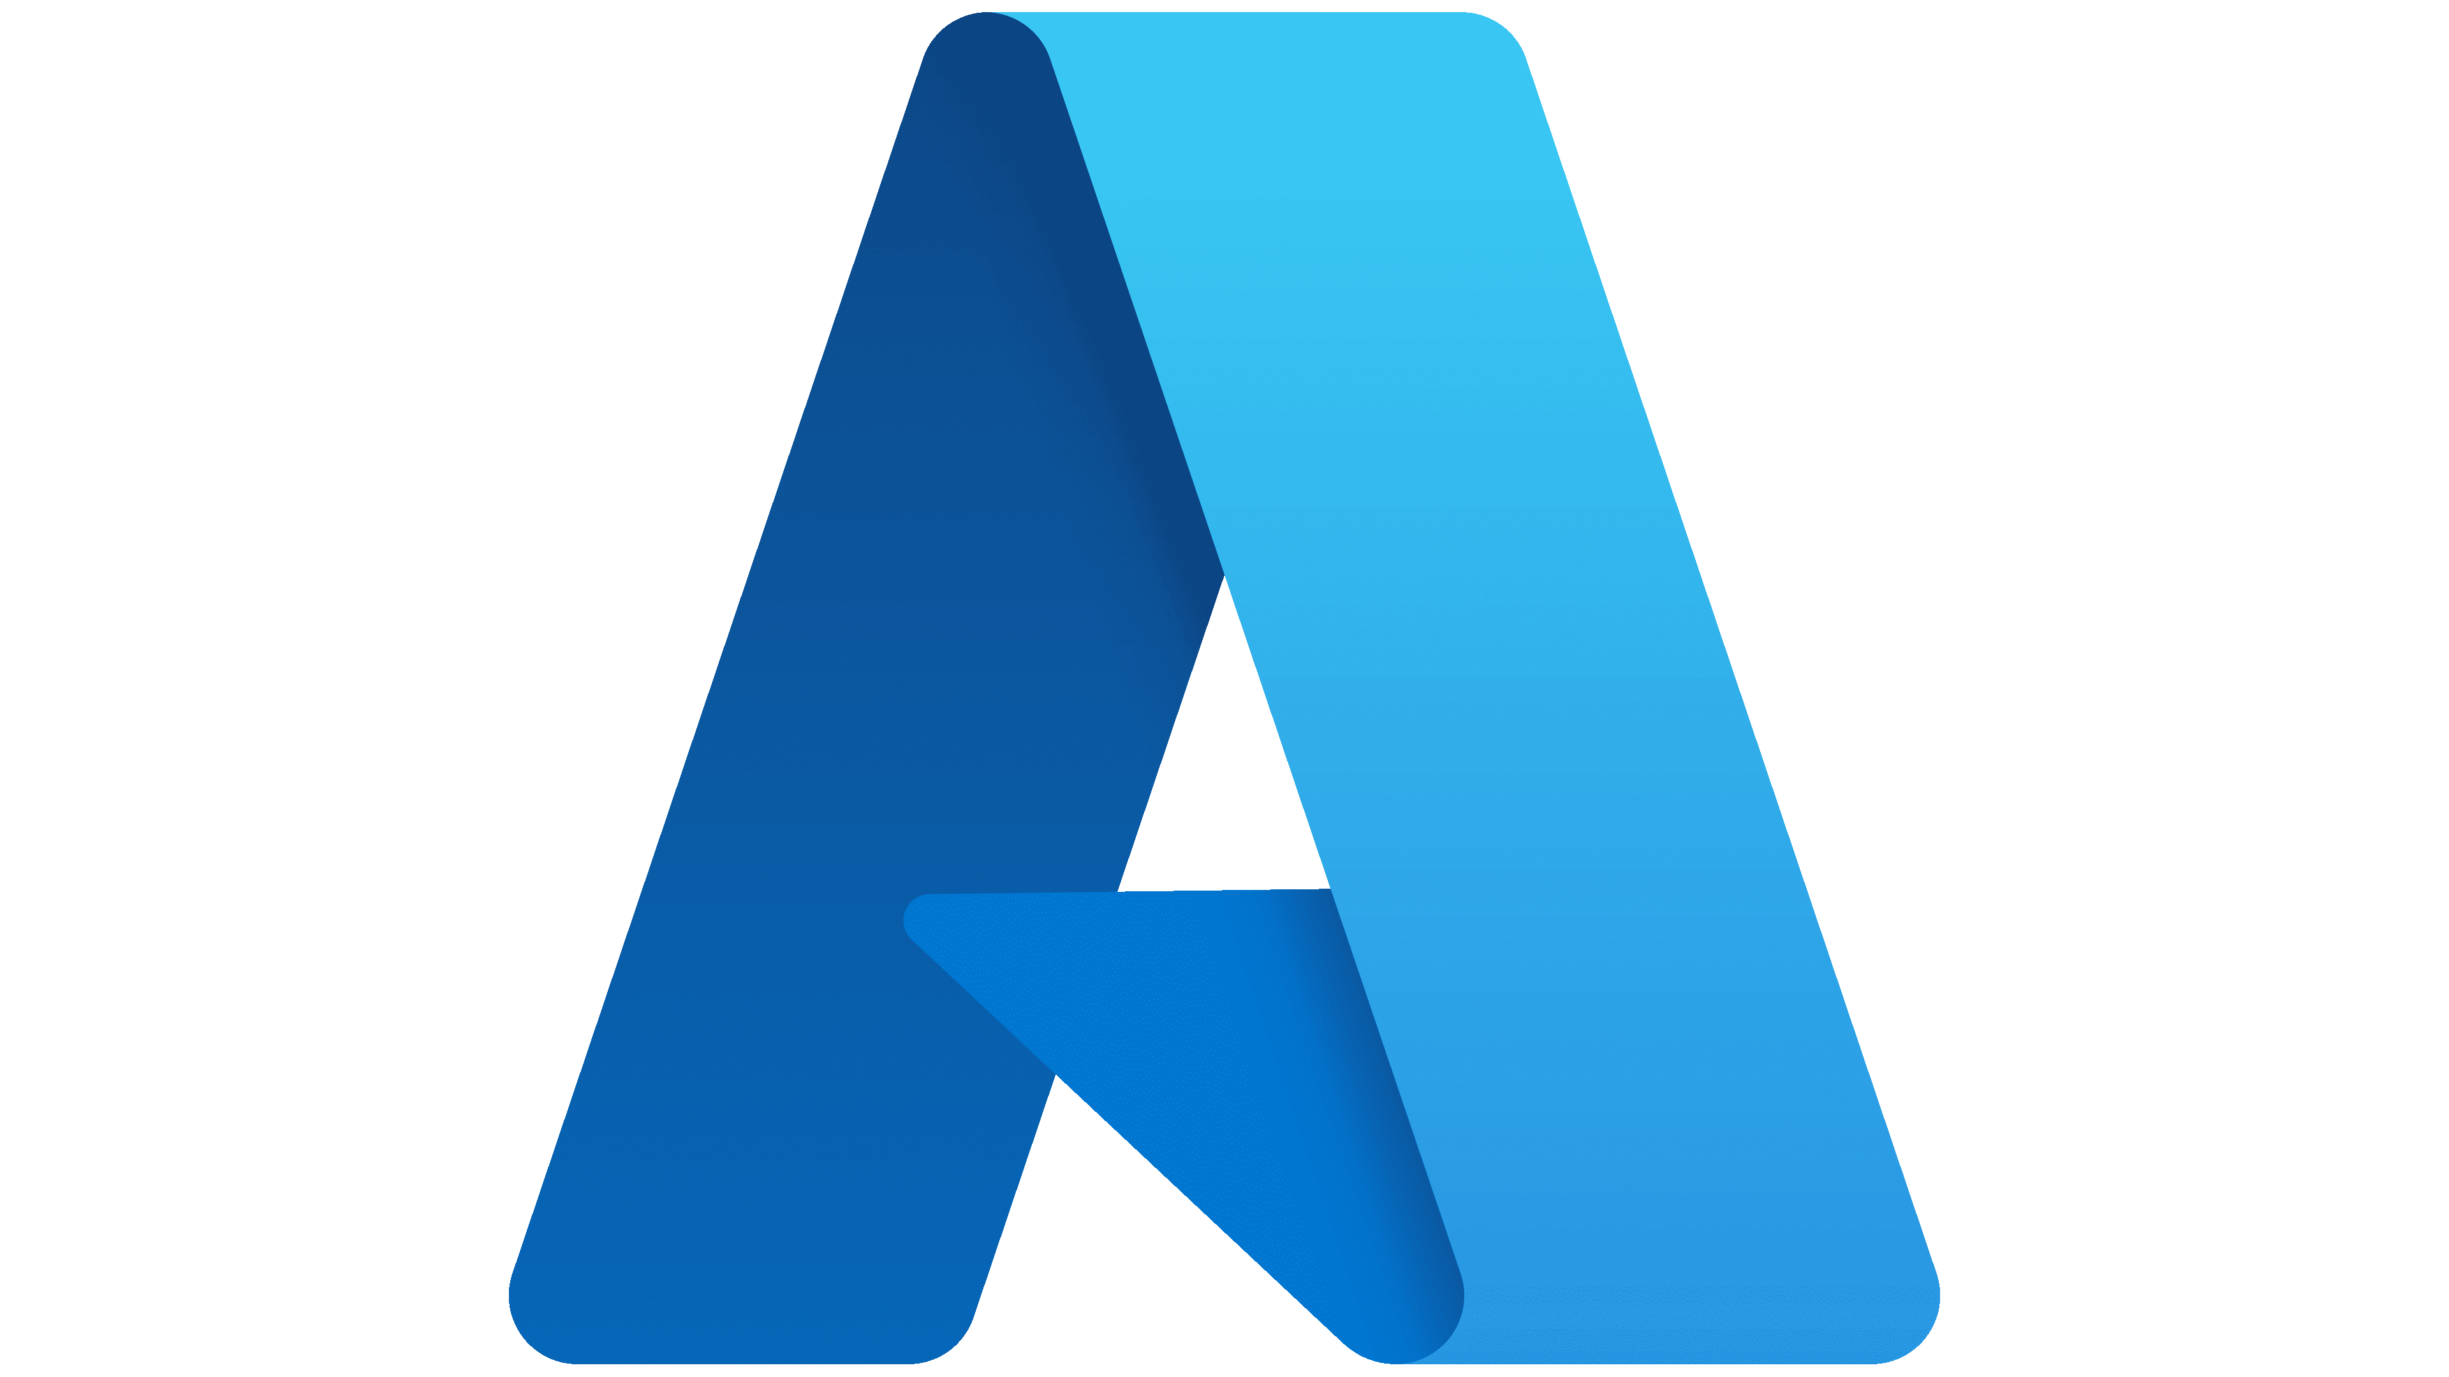

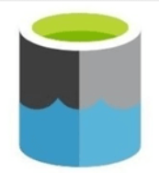





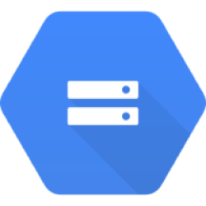



Getting data into Fabric
How to connect/load data in the private network from Fabric
Inbound
Outbound
OneLake Shortcuts
Azure PaaS
Shortcut to ADLS Gen2
Fabric Pipelines (COPY)
Fabric Spark
Amazon S3
Azure Data
Factory
Fabric Eventstreams
Fabric Pipelines (COPY)
Dataflows Gen2
GCS
OneLake
Azure
Databricks
COPY INTO DW
On-prem
S3 compatible
Azure Synapse Analytics (Spark)
On-Prem Data Gateway
VNet Data Gateway
Managed private endpoints
Trusted Workspace Access
On-Prem Data Gateway
All F SKUs
All F SKUs

Slide 28
Workspace outbound access protection

Slide 29
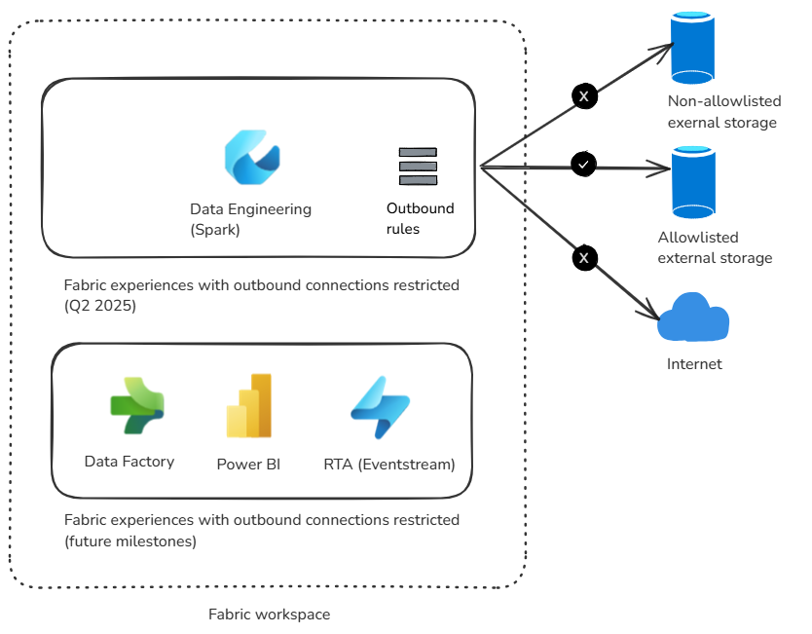
Workspace outbound access protection
Workspace level control to restrict outbound access to Public network
Restrict outbound connections to permitted destinations only
Use in conjunction with other security features to achieve robust outbound control
Upcoming: Soon for Spark. Other workloads in future milestones

Slide 30
Workspace outbound access monitoring
Fabric allows tracking user activities for connection creation and use in usage logs and purview audit.
For example:
For more details:
Create cloud connections
Create notebooks \ pipelines
Create shortcuts
Track user activities in Microsoft Fabric - Microsoft Fabric | Microsoft Learn
Data connection auditing for exfiltration protection | Microsoft Learn

Slide 31
Workspace & item security

Slide 32
Multiple layers of security and access control
Platform level access. Authentication through Entra ID. Inbound through Private Link or Conditional access
Microsoft Fabric (SaaS tenant)
Domain
Domain specific configuration. by domain admins
Workspace
Artifact
Artifact
Artifact
Artifact
Workspace level access. Boundary for managing artifacts. E.g. admin, contributor and viewers.
Compute security. e.g. Warehouse access through GRANT/DENY or Semantic Models & Warehouse RLS \ OLS.
OneLake
Files
Shortcuts
Tables
Tables
Item level access. e.g. read all only via OneLake or read access to only subset of data. More granular roles for files and folders.

Slide 33
OneLake security public preview soon
Platform level access. Authentication through Entra ID. Inbound through Private Link or Conditional access
Microsoft Fabric (SaaS tenant)
Domain
Domain specific configuration. by domain admins
Workspace
Artifact
Artifact
Artifact
Artifact
Workspace level access. Boundary for managing artifacts. E.g. admin, contributor and viewers.
Compute level
OneLake
Onelake security: Define security once and propagated to OneLake and every compute engine for access and OLS \ RLS
Files
Shortcuts
Tables
Tables
Item level
OneLake

Slide 34

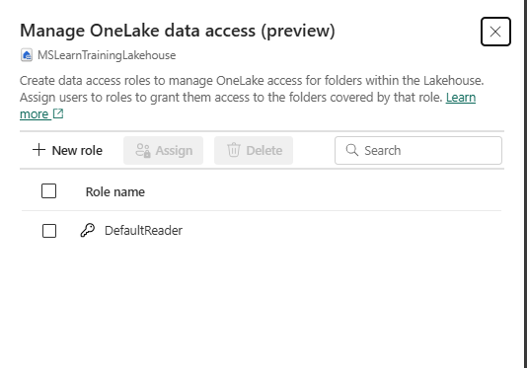
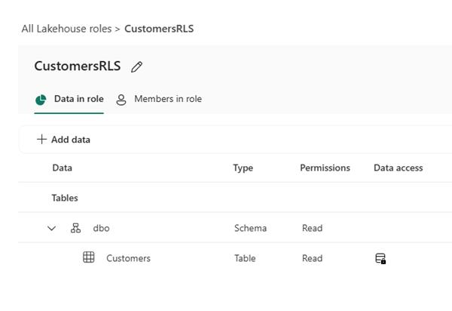
OneLake security in Fabric
Secure once and enforce across engines
Define security once in OneLake, and all engines will enforce it uniformly as they process queries and jobs, streamlining data security management and optimizing processes.
Define granular security for secure sharing
Create roles within a data item that grants access only to granular items with a lakehouse. This includes tables and folders or rows (RLS) and columns (CLS)
Centrally manage all permissions in Fabric
Use OneLake security to centrally manage roles and their permissions across all domains and workspaces in Fabric.
34
Microsoft Fabric
Notes:
Managing data security (table, column, and row levels) across different data engines can be a persistent nightmare for customers. With OneLake security in Microsoft Fabric, you can define security in OneLake, and all engines will enforce it uniformly as they process queries and jobs. Use OneLake security to centrally manage permissions across all domains and workspaces in Fabric. This release will also include the GA of Data Access Roles which will be announced under the OneLake security umbrella.

Slide 35
Secure and compliant by default

Slide 36
Fabric encryption & multi-geo: Data Residency
All data at rest is encrypted by default by Fabric. CMK for OneLake is coming soon.
Fabric multi-geo capacities allows control over content storage location in one of 54 data centers world-wide.
OneLake which logically spans the world, Workspaces can reside in different regions around the world while still being part of the same data lake.

Slide 37



Compliance with Microsoft Fabric
Microsoft Fabric is a core Microsoft online service and supports a wide range of compliance standards including:
GDPR
EUDB
ISO certifications including ISO 27001, 27701, 27017, 27018
HIPAA, HITRUST compliant
SOX compliant
SOC 1, SOC 2, Type 2
FedRamp HIGH
PCI DSS
Notes:
Workspace security
Workspaces represent the primary security boundary for data stored in OneLake. Each workspace represents a single domain or project area where teams can collaborate on data. You manage security in the workspace by assigning users to workspace roles.
For more information, see OneLake security (Workspace security).
Item security
Within a workspace, you can assign permissions directly to Fabric items, like warehouses and lakehouses. Item security provides the flexibility to grant access to an individual Fabric item without granting access to the entire workspace. Users can set up per-item permissions either by sharing an item or by managing the permissions of an item.
For information, see OneLake security (Item security).

Slide 38
Data security and governance

Slide 39






Fortify data security with Microsoft Purview
Information Protection
Discover and auto-classify data and prevent it from unauthorized use across apps, services, and devices
Understand the user intent and context around sensitive data to identify the most critical risks
Enable Adaptive Protection to assign appropriate DLP policies to high-risk users
Data Loss Prevention
Insider Risk Management
Notes:
Talk track:
Microsoft Purview offers Information Protection, Insider Risk Management, and Data Loss Prevention on one unified platform that helps organization fortify data security effectively, so you can develop a defense-in-depth approach when it comes to protecting your sensitive data.

Slide 40
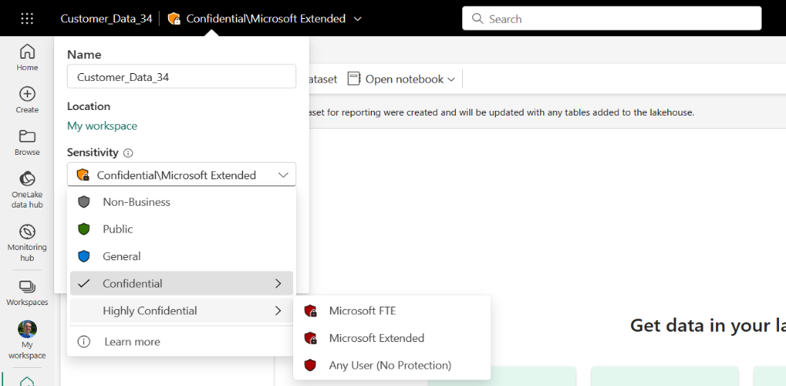
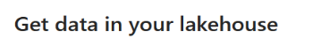
Information Protection labels
Sensitivity Labels guard sensitive content against unauthorized data access and leakage.
Travels with the data and enforced even when the data is exported to Office.
Gives insights into usage to security admin

Slide 41



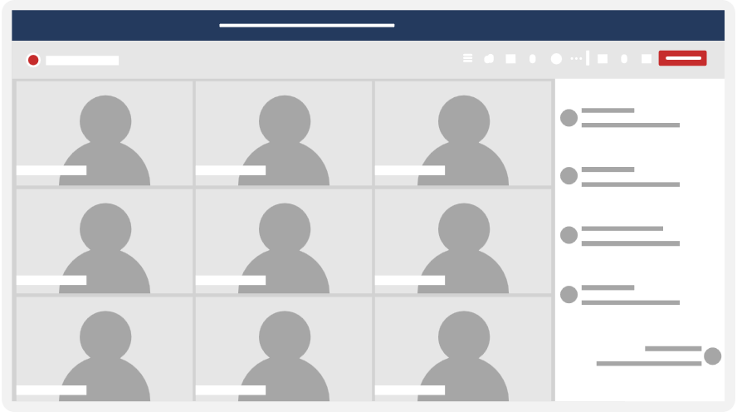


Label inheritance to prevent data security incidents
Document was not labeled, and gets exposed to external users
External vendor leaks sensitive information to press
Meeting occurs with both internal and external participants
Sensitive Power BI report is accidentally shared in chat
Data exposure
Data leakage
Highly confidential document
gets inherited from Fabric to Teams and is protected
Q3 Earnings
Data security
HIGHLY CONFIDENTIAL
Notes:
Let's walk through a scenario that might be relevant to your organization – the need to secure collaboration tools from data security incidents. Think of the number of meetings that your employees attend every day – specifically those meetings that involve both internal and external participants. [Click] Now let's think about a sensitive Power BI file that is shared over the meeting chat – that contains confidential information related to your organization's earnings – or it could contain company IP, employee PII, etc. [Click] If we follow the red flowlines, you can see what could occur if the document was not protected and in this case, gets exposed to external users. Imagine if those external users acted maliciously and leaked that sensitive information out to the press – this scenario would result in a data security incident. [Click] However, if we follow the yellow line, the document was labeled highly confidential and was inaccessible to those external users – leading to strong data security.

Slide 42
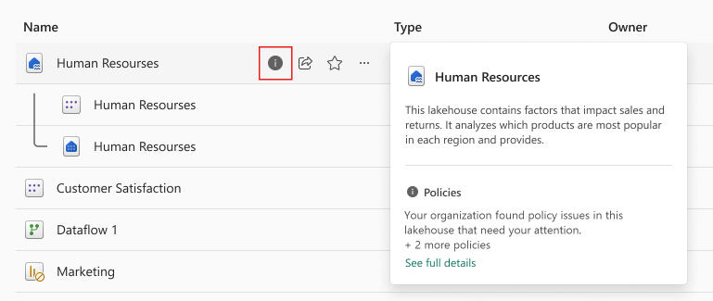
Data Loss Prevention policies
Define Purview Data Loss Prevention (DLP) Policies
Automatically detect sensitive data proactively as it is loaded
Trigger immediate risk remediation such as alerts or restrict access.

Slide 43
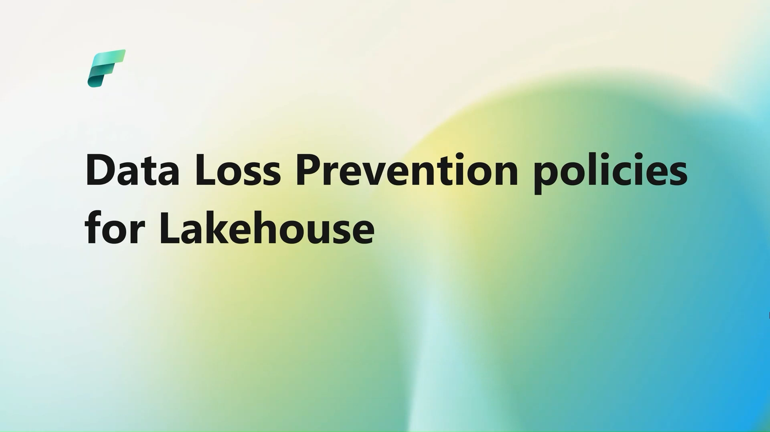
Data Loss Prevention policies for Lakehouse demo
Notes:
Speaker: Adi Regev

Slide 44
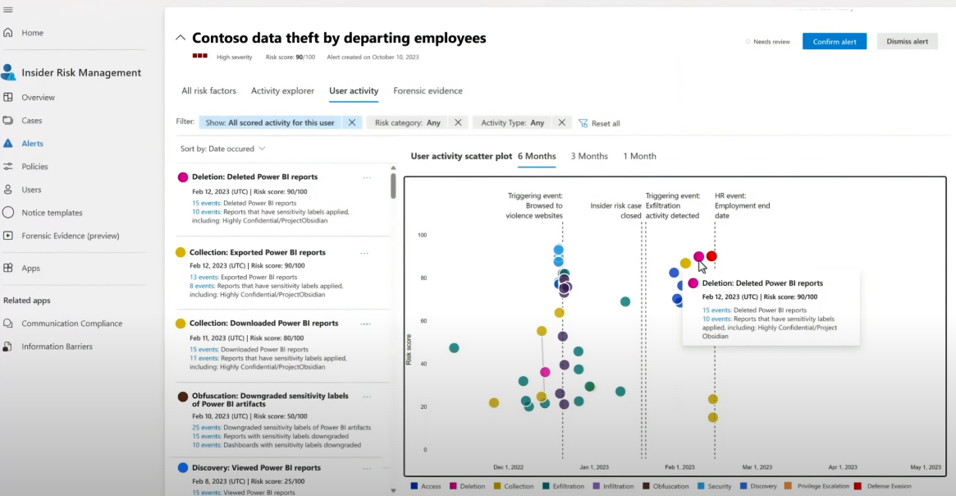
Insider Risk Management
Detect, investigate malicious and inadvertent activities in your organization based on your organization’s compliance standards.
Also covers CoPilot prompts for Power BI
Active management of risks through alerts and triage and actions

Slide 45
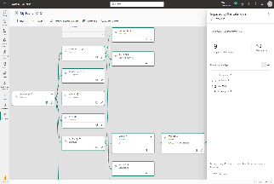
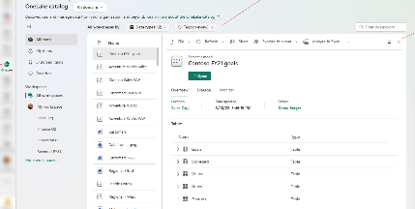
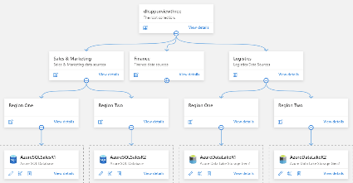
Metadata & Lineage
Explore, manage, and govern data across your organization
Fabric lineage
Track data lineage of your analytical projects to see how data flows through items and perform impact analysis to assess impact of changes. Can be extended with Scanner API’s
OneLake catalog
Centrally Find, explore, and use relevant Fabric data items in your organization. Data hub Pervasive across Fabric as well as in Teams, Excel and more.
Purview Unified Catalog
Enabling the central data office to centrally govern and manage data assets. The Purview Unified Catalog offers data stewards and data owners advanced capabilities for data curation, advanced data quality, end-to-end data lineage, and an intuitive global catalog that spans the data estate.

Slide 46
Logo

